Slide 1
Graduate Careers
in the Irish Public Service,
EU & International Organisations
Queens University Belfast
13 October 2015
Niall Leavy, Public Appointments Service & gradpublicjobs.ie
Fiona Devlin, Dept. Foreign Affairs & Trade

Slide 2
Current Campaigns
Closing date of 15th of October:
Administrative Officer
Graduate Economist
Third Secretary
Trainee Auditor
Closing date of 29th of October:
Legal Researcher

Slide 3
Key Requirements
All positions
To apply you must have (on or before the 31st of December 2015) a Level 8 Degree on the Irish National Framework of Qualifications
Junior Diplomat/Third Secretary
All applicants must be an Irish citizen
Economist
Qualification in Economics /Economic discipline or a primary honour degree at min.2.1 in which Economics is a major in the final degree
Legal Researcher
Candidates must, on or before 29th October 2015: · Hold an honours Law Degree (Level 8 in the National Framework of Qualifications) with at least 2:1 honours or a recognised relevant professional legal qualification

Slide 4
Trainee Auditor - Key Requirements
qualified accountant
or
have sat and passed at least the first level of recognised professional accountancy examinations in an accountancy body regulated by the Irish Auditing and Accounting Supervisory Authority (IAASA)
or
hold a qualification (a primary 2.1 honours degree Level 8 National Framework of Qualifications or above in a higher relevant discipline) acceptable to any of the recognised accountancy bodies for exemption from (ii) above
or
anticipate that they will be entitled to hold, by 31st December 2015, a qualification (a primary 2.1 honours degree Level 8 National Framework of Qualifications or above in a relevant discipline) acceptable to any of the recognised accountancy bodies for exemption from (ii) above

Slide 5
Administrative Officer in the Irish Civil Service
Starting Salary: €29,922
Annual Leave: 25 days
Crucial role in policy and strategy formulation
economic,
financial,
international,
environmental,
social issues.

Slide 6
Graduate Economist with IGEES
Starting Salary: €29,922
Annual Leave: 25 days
The role
Policy development
Conducting expenditure and policy analysis
Analysing
Reviewing business cases;
Value for Money reviews,
Focused Policy Assessments
Appraisals - Cost benefit and cost effectiveness analyses;
Analysis of tax policies and evaluation of tax policies;
Economic advice and guidance

Slide 7
Trainee Auditor with Auditor General
Conditions of Service
Starting Salary: €29,922
Annual Leave: 25 days
tailors audit programmes
Carries out audit work
Evaluates and reviews financial statements against the evidence collected
Raises audit concerns
Drafts sections of audit reports
topic identification
analyse audit data
Travel - audits located outside of Dublin

Slide 8
Third Secretary / Diplomatic Stream with Department of Foreign Affairs & Trade
Starting Salary: €29,922
Annual Leave: 25 days
public affairs, foreign policy and international relations
project key messages abroad
programme of development cooperation
Resilience and resourcefulness in challenging situations,
Foreign languages
Communication Skills
Build and maintain relationships and co-operation
Present a position and persuade others of its benefit
Energy and commitment

Slide 9
Legal Researcher in eg DPP, AG’s, Houses of Oireachtas
Starting Salary: €29,922
Annual Leave: 25 days
Tenure: 3 year Contract
knowledge of Irish law and the Irish legal system
Legal research skills
Information technology skills,
Prioritise and manage assigned tasks in a busy environment and work within deadlines,
Knowledge of current legal issues, legislative developments and cases
Excellent communication and interpersonal skills
The ability to work independently and in a team environment
Desirable Skills/Attributes (but not essential):
Familiarity with the law of the European Union, human rights law, constitutional law, administrative law and the law of evidence

Slide 11
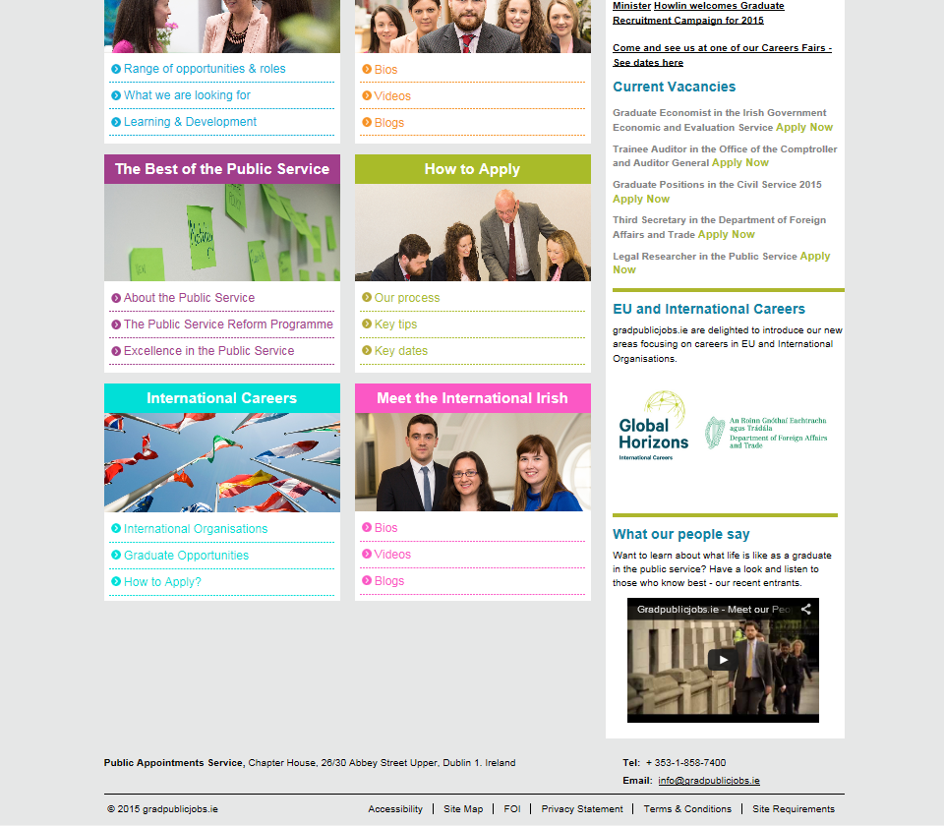

Slide 13
What we are looking for …
3
A strong track record of achievement … plus:
excellent communication (oral and written), presentation and interpersonal skills
the capacity to carry out research, analysis and problem solving
experience of effective team-working and delivering to tight deadlines
the capacity to work in a multidisciplinary environment and exhibit leadership potential
the capacity to show initiative while working with minimal supervision
evidence of working on projects and producing results within budget and deadlines:

Slide 14
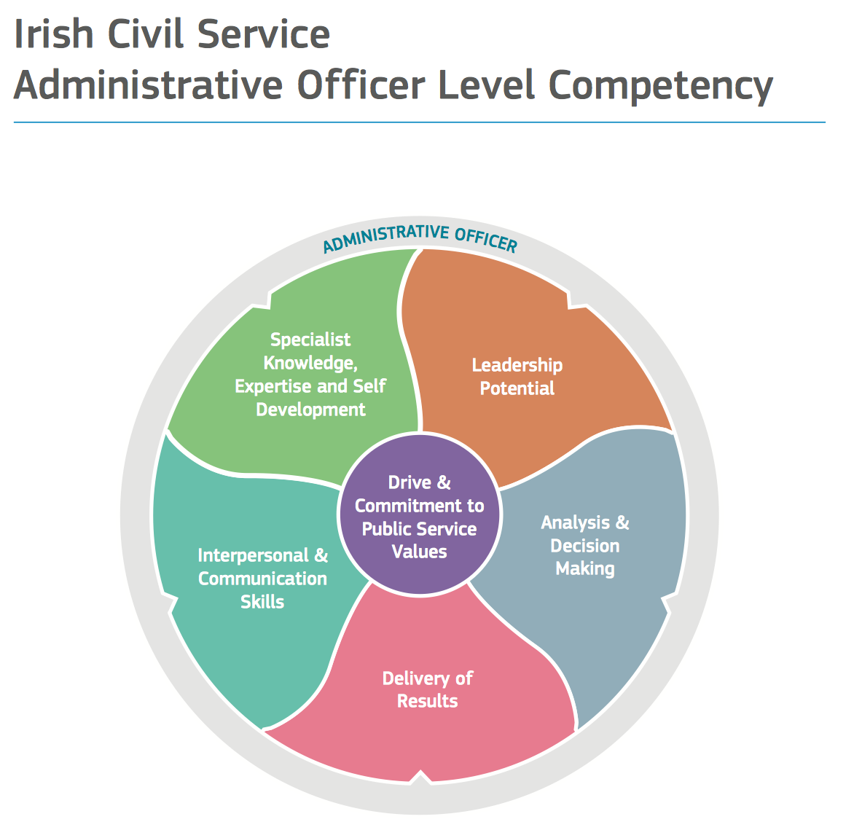
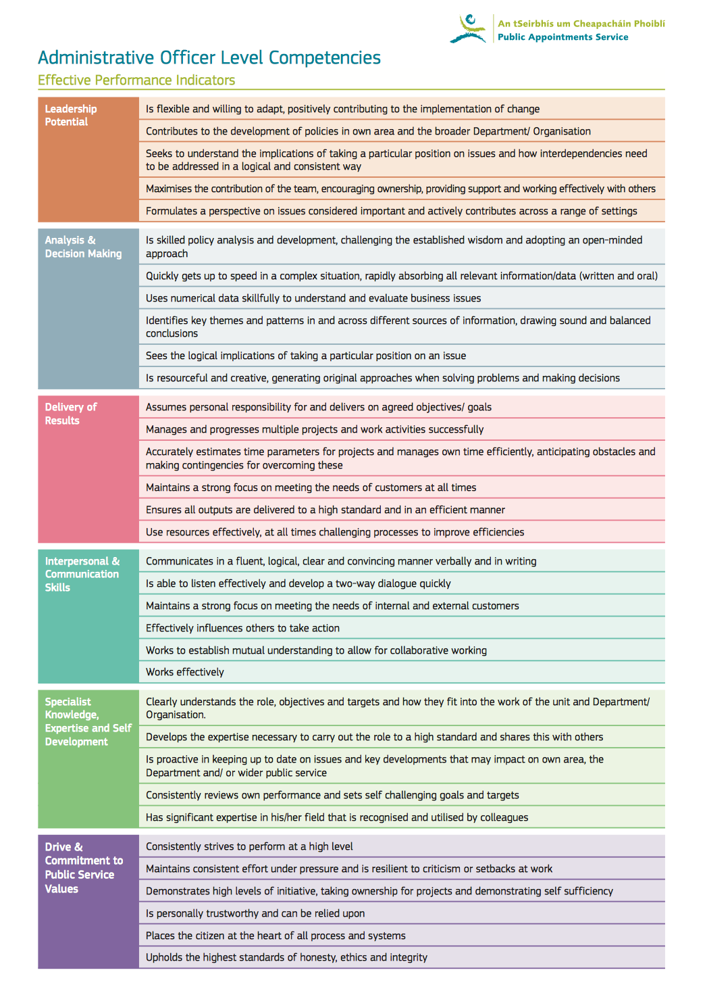

Slide 15
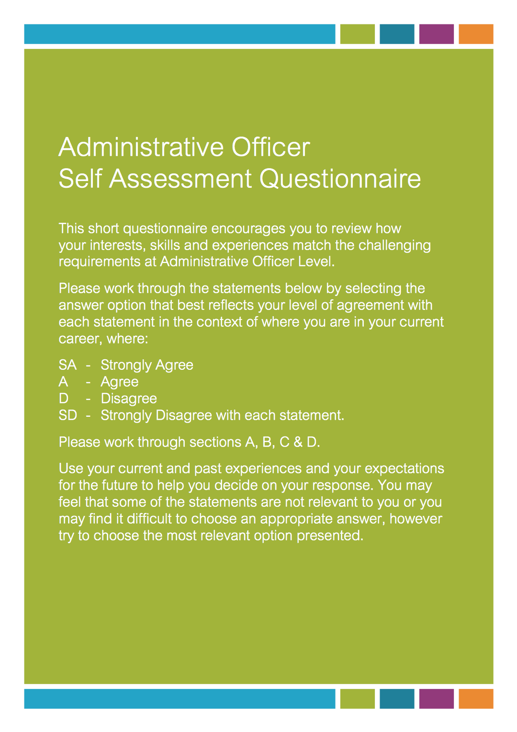
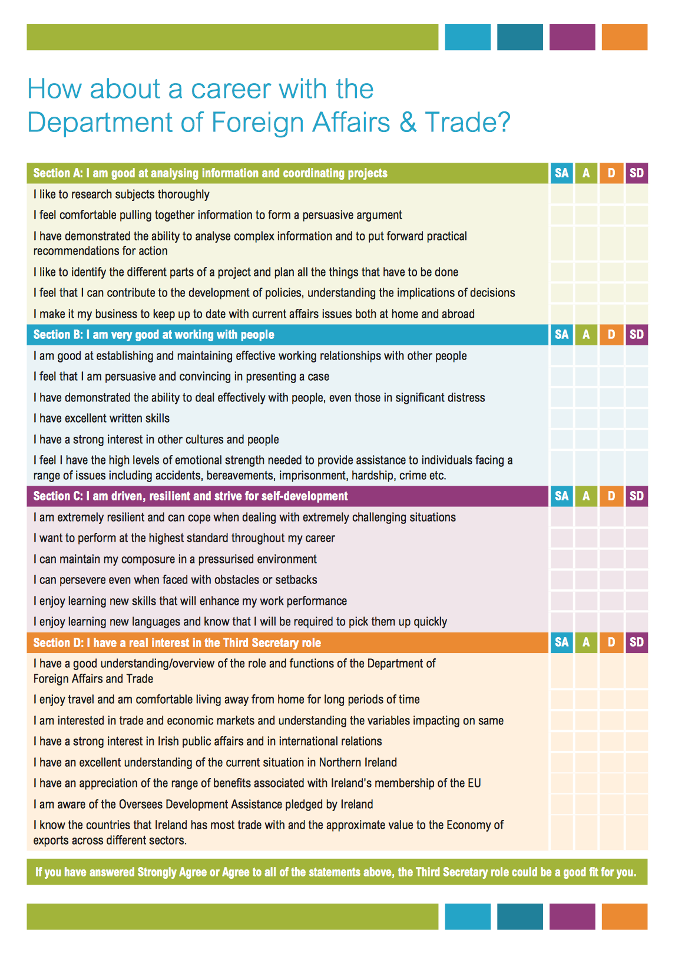

Slide 16
‘Early responsibility ... ‘ ‘work on important & real issues ...’ ‘Apply your degree to your work ... ‘ ‘WLB – can also enjoy other aspects of your life ...’
‘Clear career progression paths ...’
‘Friendly & Supportive work environment / atmosphere ... ‘ ‘Great learning & development supports...’ ‘Competitive salary ....’

Slide 17
Overview of our process

Slide 18
NEW Graduate Development Programmes 2015
Civil Service GDP x 80
Local Government GDP x 120
Economists GDP x 17

Slide 19
Civil Service Graduate Development Programme

Slide 22
Doing your best …

Slide 23
Straightforward / Short Online Application

Slide 24
Doing your best … Online Tests
Practice, Practice, Practice
Try out Self-Assessment & Sample Tests on gradpublicjobs.ie
Quiet Environment
Ensure good connection
Dress Comfortably
Protect time / ensure no distractions

Slide 25
Doing your best … During the Test Session
Read the instructions carefully
Attempt as many questions as you can
Work quickly & accurately - push yourself
Difficult questions - try to eliminate the wrong answers first
Job simulations / scenarios - choose what you would most likely do based on the info available
Job simulations / scenarios - marks typically available for every answer option - so answer as many question as you can.

Slide 26
Doing your best … Preparing for the Interview
Research the organisation & role you are applying for
Review your own strengths, skills & experiences
Write down a list of your achievements / what you are most proud of
Carefully examine the skills required for the role
Draw on your own best examples of where you have demonstrated these / similar skills
Highlight a number of key messages that you would like to communicate;
Give some thought to ‘WHY’ ‘YOU’ want this job
Give some thought to how this opportunity compares to other quality options you may be considering - why is this your ‘preferred option’
Identify the one question you hope is not asked … and do up an answer;
Build your confidence - practice your answers – either on your own or to someone
Know what is in your application form / keep a copy to review

Slide 27
Doing your best … at Interview … DO’s … ✓✓✓
Remember that the interview board are “willing you on”;
Remember that you are talking about the most interesting subject in the world – YOU …!!
Remember that sometimes when a candidate is doing really well, the board will ask them even more challenging questions to really stretch them;
Refer to your application form/notes if necessary;
Admit if you don’t know something;
Keep your energy levels & your enthusiasm up through the whole interview;
Good eye contact with Interviewers throughout.

Slide 28
Doing your best … at Interview … DON’T … ✗✗✗
Spend your interview kicking yourself over something you said earlier that you think might have made you sound stupid;
Apologise for being nervous – often it doesn’t show;
Use humour inappropriately;
Feel you have to respond to a question instantly;
Make the interview combative/ adversarial.

Slide 29
Apply Now
On gradpublicjobs.ie
Thank you

